Slide 1


Antonio Hollerman
10/14/23

Slide 2

Outline
Executive Summary
Introduction
Methodology
Results
Conclusion
Appendix

Slide 3
Executive Summary
Data was extracted from appropriate Wikipedia tables and open-source JSON files
Data is cleaned by replacing ‘nan’ values with the average or removed row. And created a ‘Class’ column with the value 1 or 0 signifying if the first stage was recovered
With the data a dashboard was created to express the data
With the data multiple models were created to predict if the first stage will be recovered
Models were then evaluated to find the best model

Slide 4
Introduction
This project aims to answer the question of how much it will cost to send a rocket to space with the probability of being able to recover the first stage of the rocket takeoff.

Slide 5

Section 1

Slide 6
Methodology
Executive Summary
Data collection methodology:
Describe how data was collected
Perform data wrangling
Describe how data was processed
Perform exploratory data analysis (EDA) using visualization and SQL
Perform interactive visual analytics using Folium and Plotly Dash
Perform predictive analysis using classification models
How to build, tune, evaluate classification models

Slide 7
Data Collection
Data came from SpaceX Api and web scraping Wikipedia tables
Data was then wrangled to only need attributes
Added a classification column called ‘class’ that signifies if the first stage was recovered
1 – recovered
0 – not recovered

Slide 8
Data Collection – SpaceX API
Spacex API Link
SpaceX API
(Data Source)
Wrangle Data
Format / Cleaning

Slide 9
Data Collection - Scraping
Scraping Link
Wikipedia
(Data Source)
Wrangle Data
Format / Cleaning

Slide 10
Data Wrangling
All the unique outcomes were extracted
Then mapped to a good or bad outcome based on whether it landed or not.
Finally, while iterating over the ‘Outcome’ column a new column ‘Class’ classified the value one or zero.
One – Good outcome / first stage landed
Zero – Bad outcome / first stage didn’t land
Wrangling Link
Outcome column
Outcomes
Spilt
Outcomes mapped
Mapped outcomes is not Class column

Slide 11
EDA with Data Visualization
Bar, line, and dot graphs were created to display any attributes that significant correlation with the probability of the first stage landing.
DataViz Link

Slide 12
EDA with SQL
The queries help gather information as in “When was the first recorded launch”, “What boaster versions did the highest payload mass”, etc
SQL Link

Slide 13
Build an Interactive Map with Folium
The map displays the different launch locations from the data set and clusters colored coordinated green or red for if the launch was successful or not.
Folium Map Link

Slide 14
Build a Dashboard with Plotly Dash
The pie graph shows the amount of successful first-stage recoveries in comparison to different launch sites. When a specific launch site is selected it shows the amount of successful first-stage recoveries in comparison to the failed for the site selected.
The dot plot shows the correlation of the payload mass to whether the first stage recovered or not.
Dash App Link

Slide 15
Predictive Analysis (Classification)
I was able to find the best parameters for each classification algorithm by experimenting with different parameters passed to the grid search and the parameters that make the model the most accurate will be saved.
Predictive Analysis Link

Slide 16
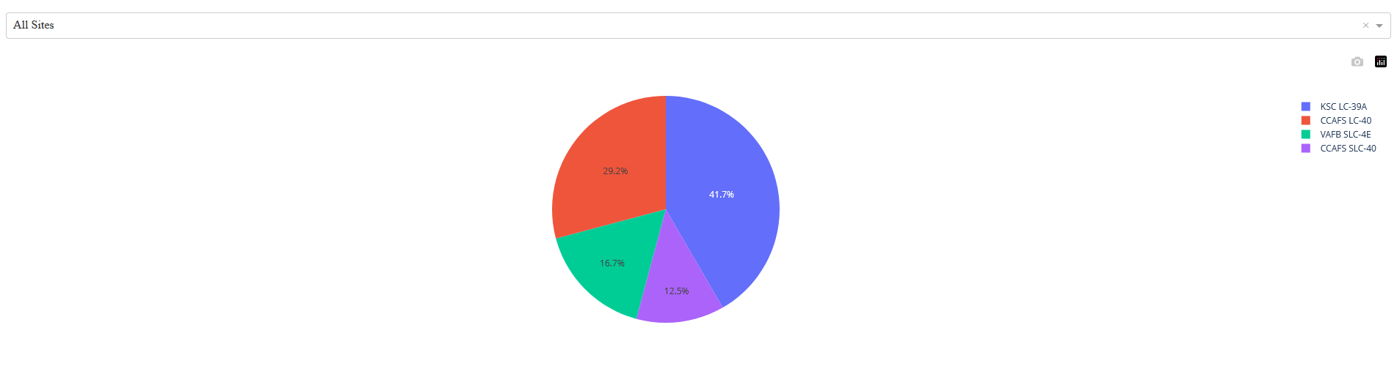
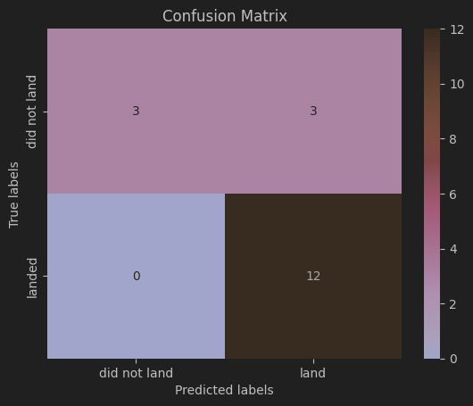
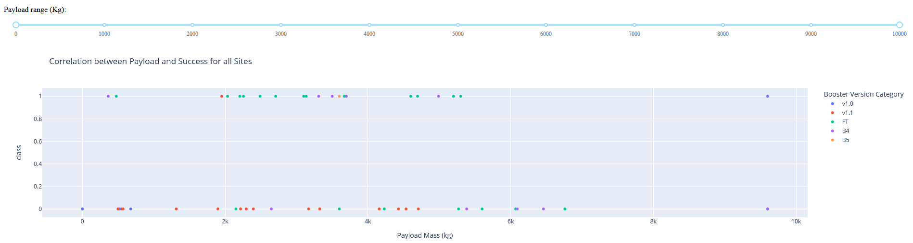
Results

Slide 17

Section 2

Slide 18
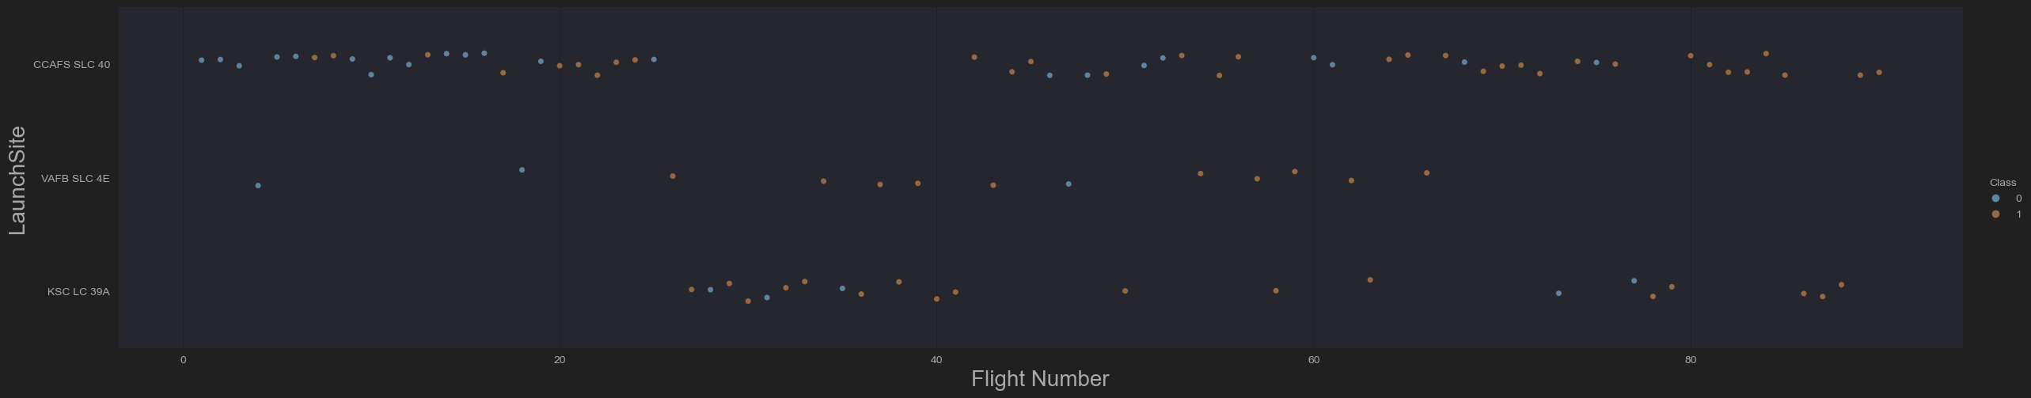
Flight Number vs. Launch Site
The scatter plot shows the flight numbers mapped to its respective launch site

Slide 19
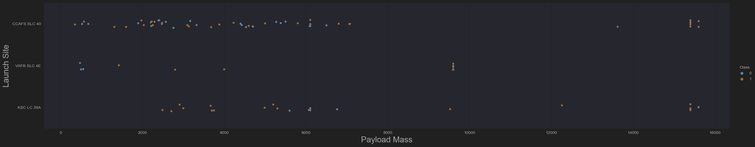
Payload vs. Launch Site
The plot shows the mass of each launch with the site it launched from

Slide 20
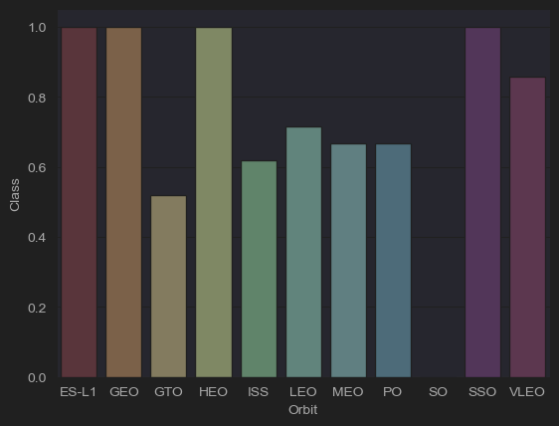
Success Rate vs. Orbit Type
The chart displays the average success rate for each orbit

Slide 21
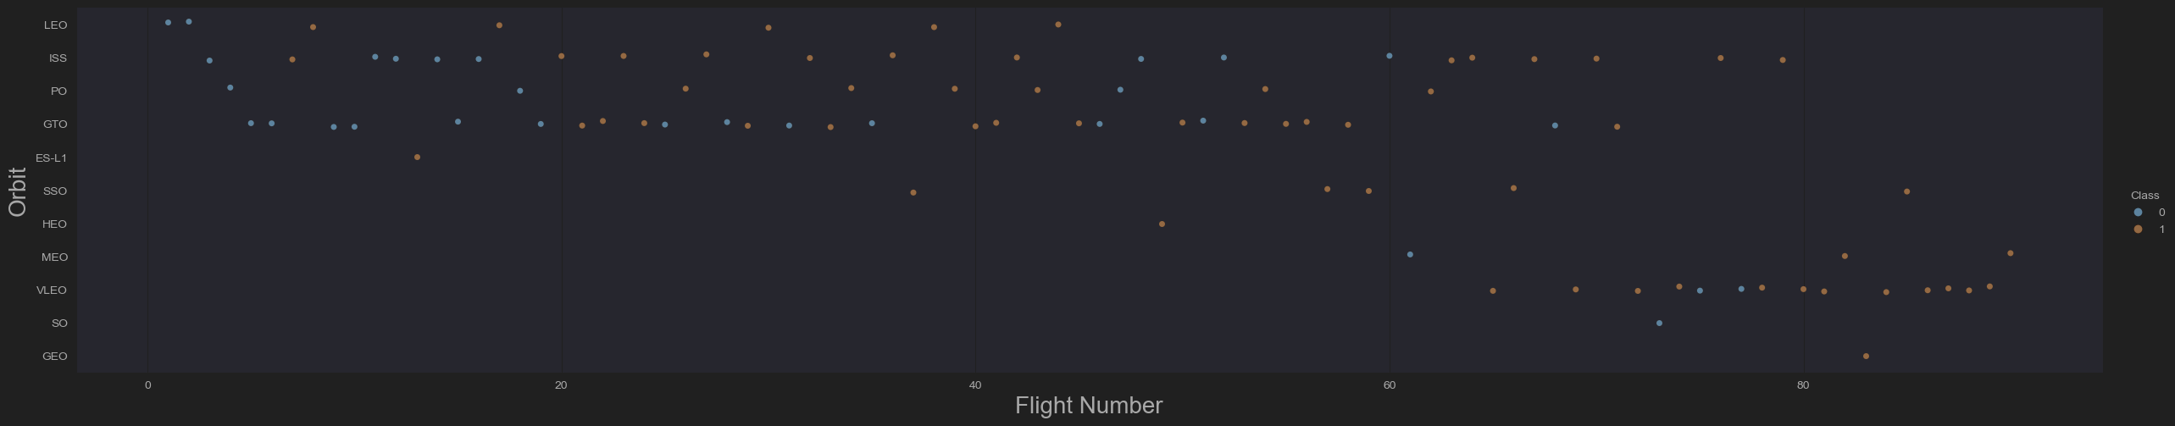
Flight Number vs. Orbit Type
The scatter plot maps each flight number to its respective orbit

Slide 22
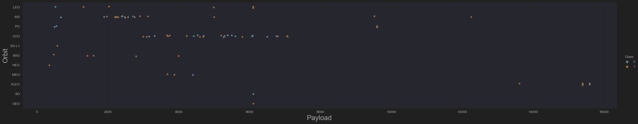
Payload vs. Orbit Type
The scatter plot maps each launch payload mass to its respective orbit

Slide 23
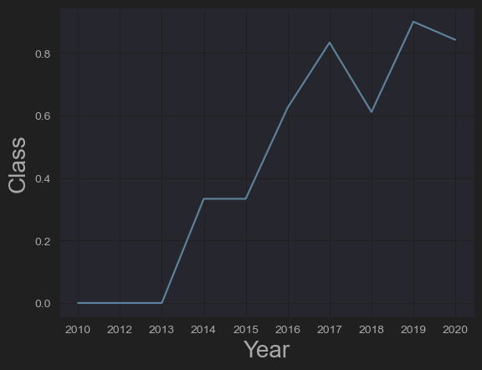
Launch Success Yearly Trend
Shows the correlation between the chances of a successful recovery and the year of launch

Slide 24
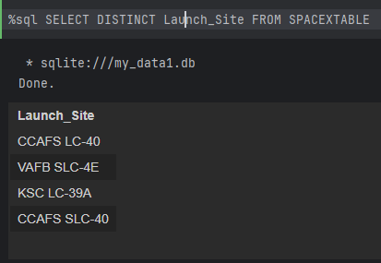
All Launch Site Names
Displays all the unique launch sites

Slide 25
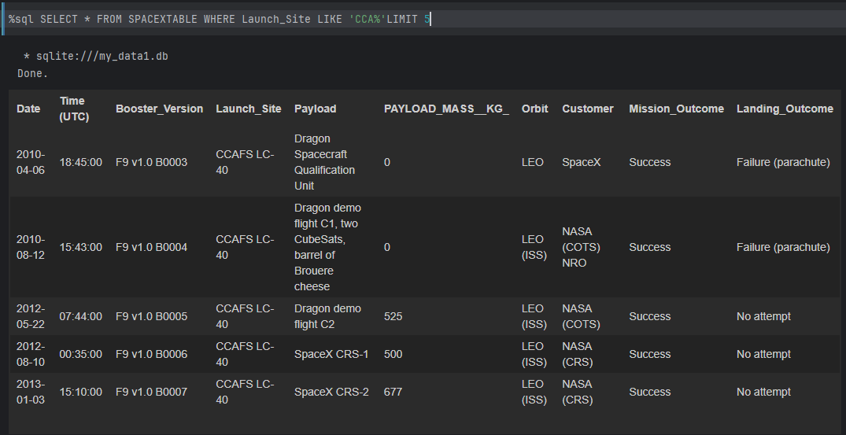
Launch Site Names Begin with 'CCA'
First five records that have the launch site begin with “CCA”

Slide 26
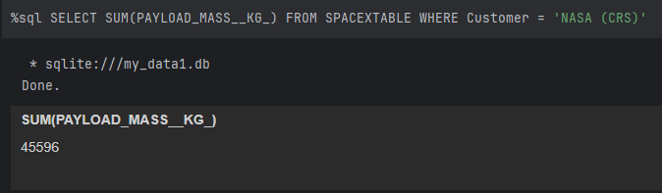
Total Payload Mass
Calculates the total payload carried by boosters from NASA

Slide 27
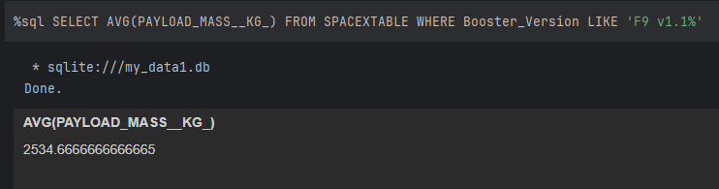
Average Payload Mass by F9 v1.1
Calculates the average payload mass carried by booster version F9 v1.1

Slide 28
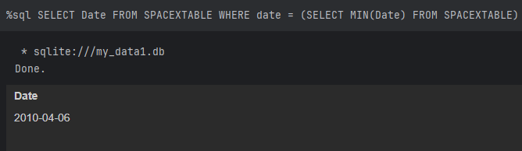
First Successful Ground Landing Date
The date of the first successful landing outcome on ground pad

Slide 29
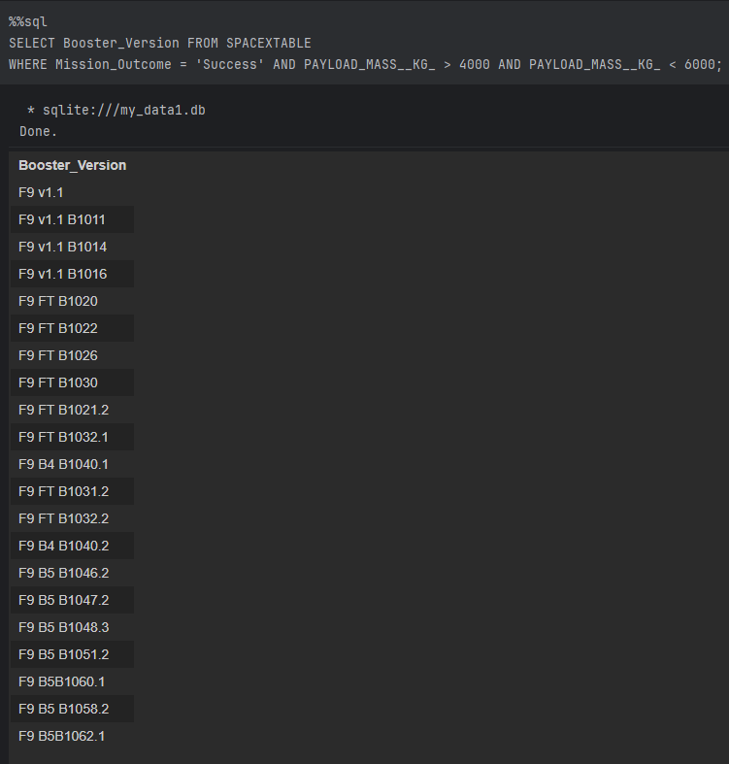
Successful Drone Ship Landing with Payload between 4000 and 6000
Names of boosters that have successfully landed on drone ships and had payload mass greater than 4000 but less than 6000

Slide 30
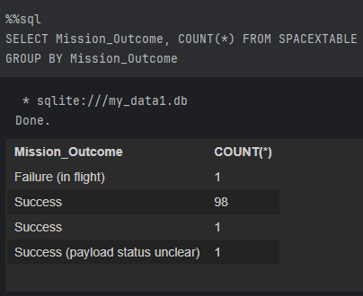
Total Number of Successful and Failure Mission Outcomes
Calculates the total number of successful and failed mission outcomes

Slide 31
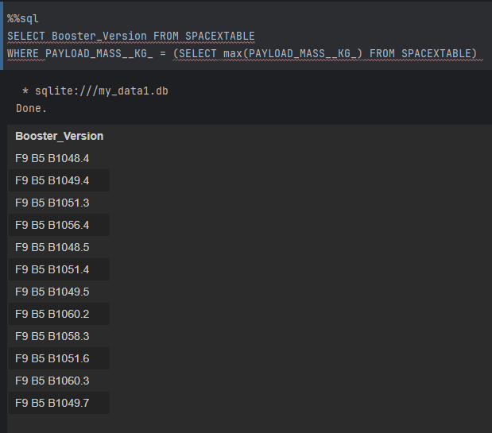
Boosters Carried Maximum Payload
Names of the boosters which have carried the maximum payload mass

Slide 32
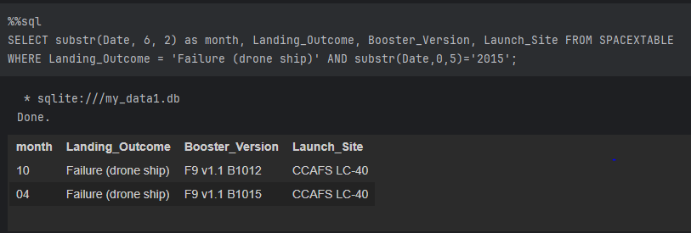
2015 Launch Records
List the failed landing outcomes in drone ship, their booster versions, and launch site names for in year 2015

Slide 33
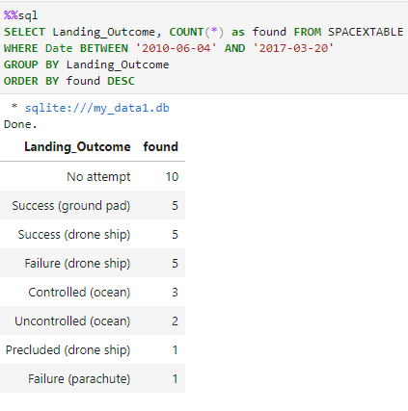
Rank Landing Outcomes Between 2010-06-04 and 2017-03-20
Ranked the count of landing outcomes (such as Failure (drone ship) or Success (ground pad)) between the date 2010-06-04 and 2017-03-20, in descending order

Slide 34

Section 3

Slide 35
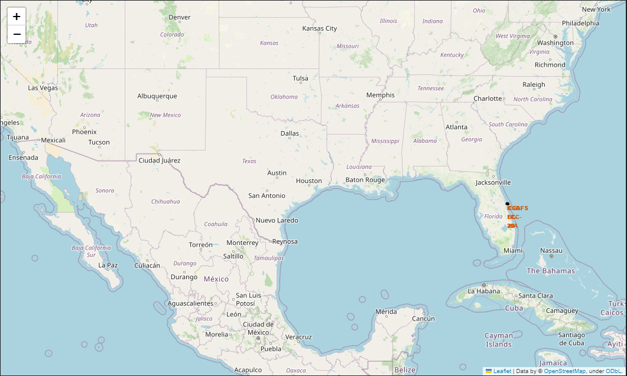
Site's locations

Slide 36
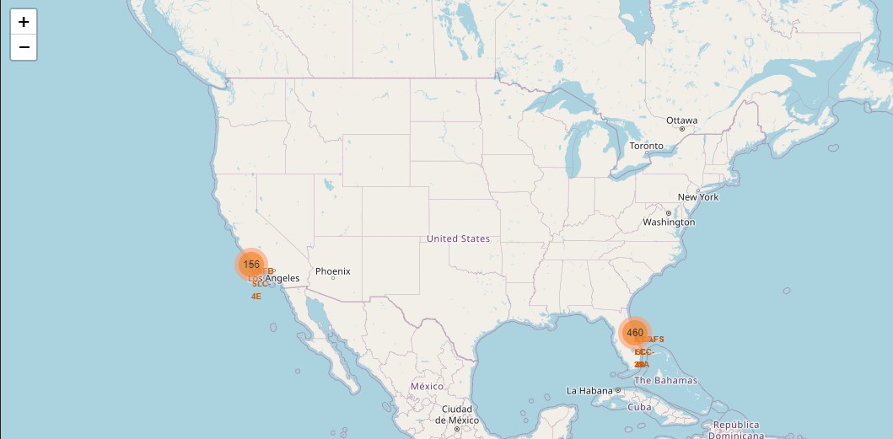
Outcomes are colored

Slide 37

Section 4

Slide 38
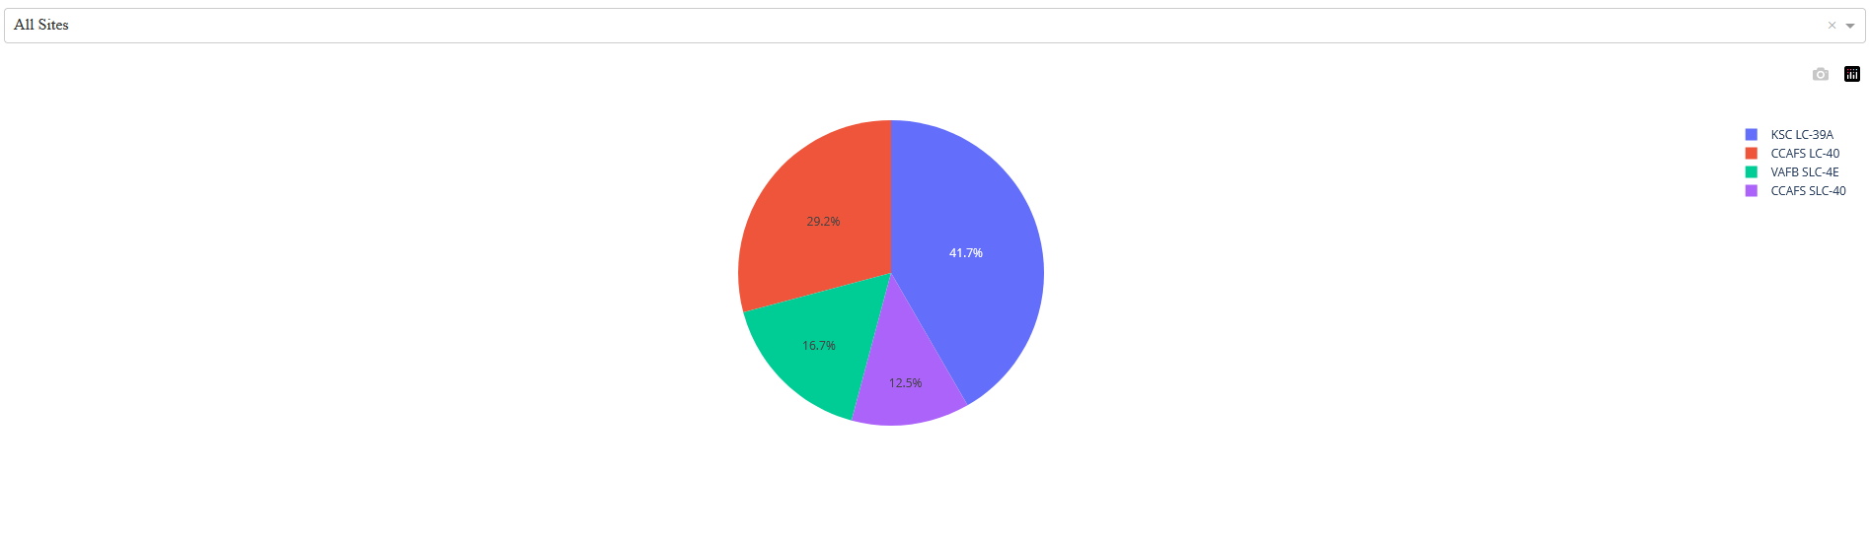
Success launches between all the sites

Slide 39
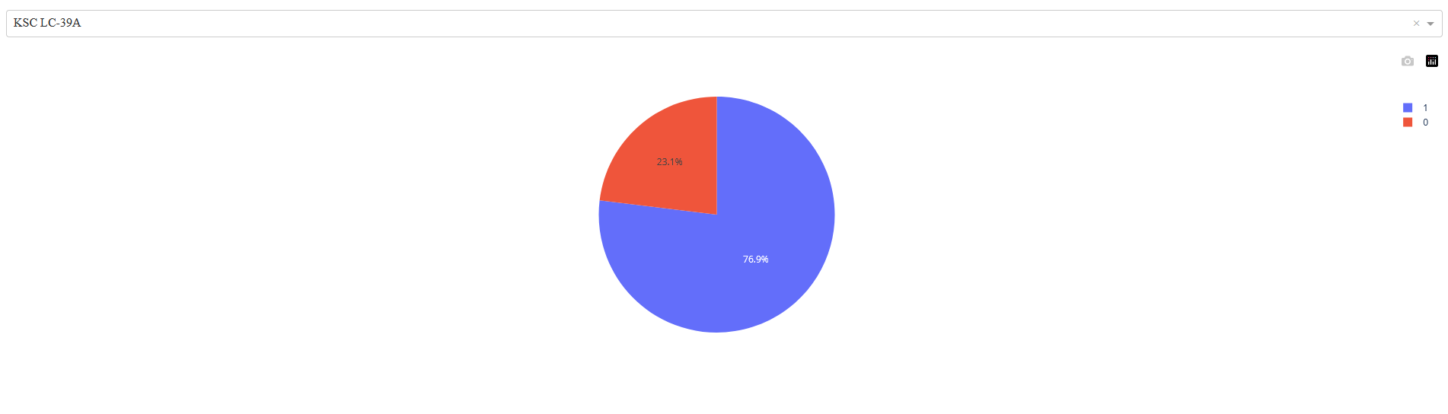
KSC LC-39A success to failed ratio

Slide 40
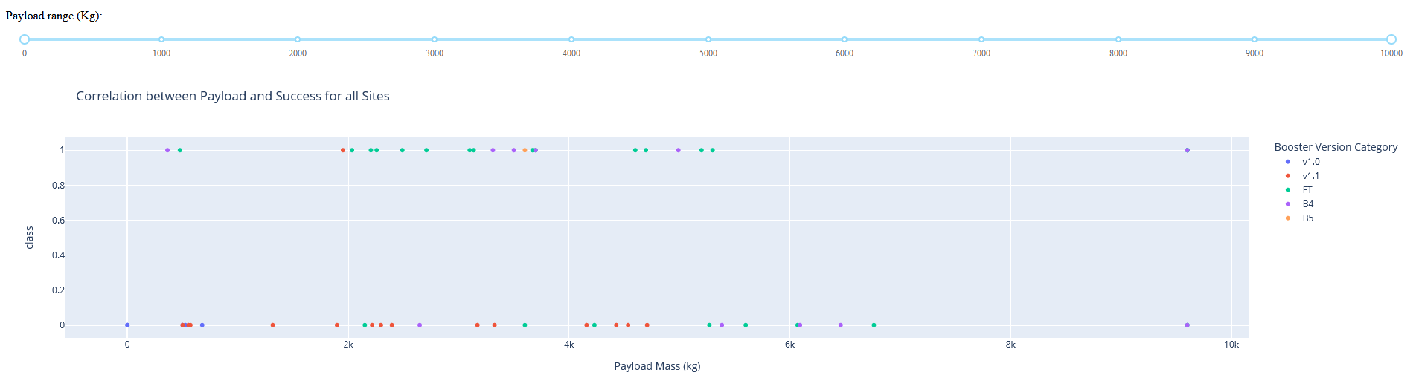
Payload vs. Launch Outcome

Slide 41

Section 5

Slide 42
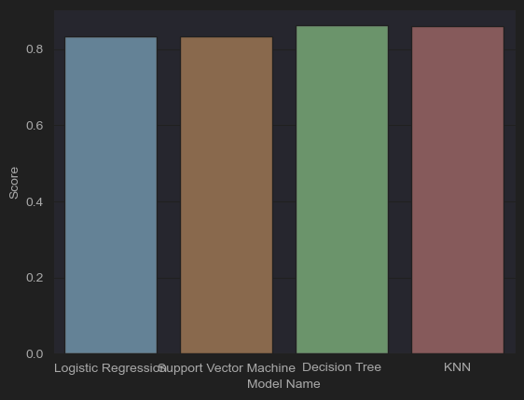
Classification Accuracy
The Decision Tree model have the highest score

Slide 43
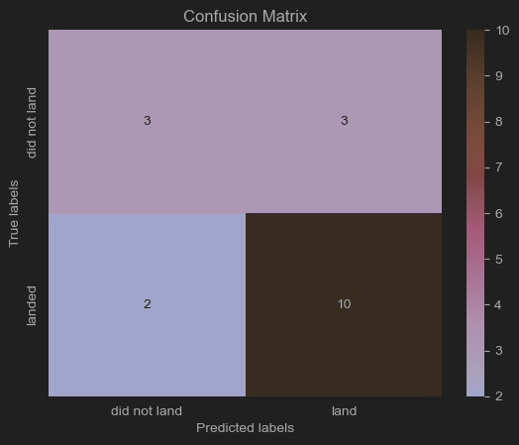
Confusion Matrix
This is the confusion Matrix for the Decision Tree matrix

Slide 44
Conclusions
Using classification models, we can predict if the launch will land or not
A tree model is the most accurate
Logistic Regression is also a valid option because you can get the probability of a land

Slide 45
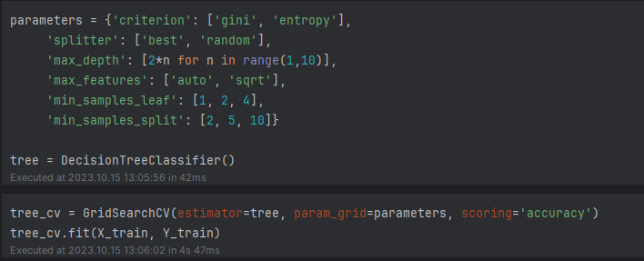
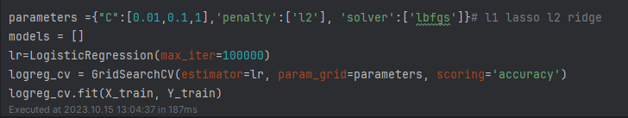
Appendix
Decision Tree Model
Logistic Regression Model

Slide 46


